Slide 1
Usage of SVM for Categorical and Numeric Features
By Douglas Slater

Slide 2
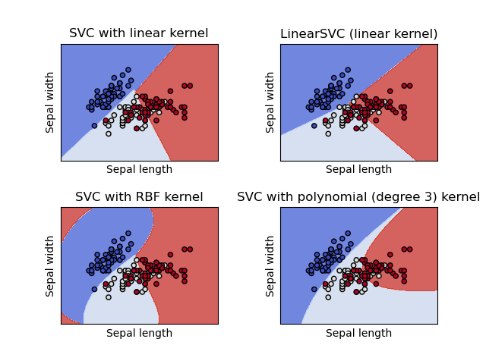
How SVM Works
SVM (Support Vector Machines) utilizes hyperplanes in multidimensional fields in an attempt to classify data.
If the provided data contains a non-linear relationship between data points, SVM uses a “kernel trick” and abstracts the data into a non-linear higher-dimension field in which it can attempt to find pseudo-linear hyperplanes that better match the data.
Different kernels can be used with SVM implementations depending on the anticipated relationship between data points.

Slide 3
SVC (Support Vector Classification)
One form of SVM is SVC, used for data classification
SVM hyperplanes are used to divide data points such that datapoint location in the field determines predicted membership
This version is useful when the label is a discrete, classifiable value

Slide 4
SVR (Support Vector Regression)
Another form of SVM is SVR, used for regression
What differentiates SVR from traditional linear regression is utilization of a kernel trick to allow the mathematically simpler linear regression to take place in higher dimensional spaces with data points with generally non-linear relationships.
This version is useful when the label is a continuous, numerical value

Slide 5
Numerical VS. Categorical Features in SVM
While SVC and SVR produce different types of outputs, the underlying algorithm does seemingly prefer continuous, numerical features
It is possible to implement categorical features of a sort into SVM through usage of “dummy variables”, but this necessitates higher dimensional fields and thus greater computing power
It also requires solving of an issue; the fundamentally different relationship between categorical values
Simple correlation between categorical values with dummy variables may lead SVM to the false assumption that the dummy variable values have a mathematical relationship where none exists. Since SVM generates its hyperplanes through calculation of distance between datapoints and the plane, features with a fundamentally non-numeric nature do not map well to a euclidean field.

Slide 6
One Way to Implement Categorical Features
A multi-leveled approach here may be beneficial
A state as a feature in itself contains no numerical significance, so SVM cannot do much with it alone
However, if one layer of SVM is used to attach a numerical weight of sorts to each state (whether a state tends to have a higher or lower rate of hospitalization per infection), this then allows state differentiation to become useful in broader attempts at prediction
This can also work in the other direction: generalized trends found in hospitalization rate can be used to assess how “good” each state’s hospitalization rate
The mathematical relationship between a state and hospitalization is endlessly recursive in our context of numerical data analysis, so we must make a decision as to whether hospitalization is a predictor of state value or state value is a prediction of hospitalization

Slide 7
Categorical Features: Continued
Another pertinent example of categorical features is date
Though time and date are ostensibly numerical, our formatting of date manifests it, in reality, as a category instead.
Example: In our dataset, date is formatted as ‘YYY-MM-DD’. While we know, for instance, that ‘2020-04-15’ takes place directly after ‘2020-03-31’, these are arbitrary designations to the algorithm.
Splitting date into composite values of month, day, and year don’t work either, as in this case the algorithm cannot correctly differentiate between and their proper relations
I propose converting our date values to a single, discrete time value

Slide 8
Which is Better for Our Project?
While SVC has its uses, SVR will be of much more help for prediction of hospitalization rate
Whether we decide to ultimately express hospitalization rate categorically (low, medium, high, etc.), the meaning of hospitalization rate is fundamentally continuous and numerical, and so categorizing it is necessarily a layer of abstraction

Slide 9
References
https://scikit-learn.org/stable/modules/svm.html
https://www.analyticsvidhya.com/blog/2020/03/support-vector-regression-tutorial-for-machine-learning/
https://stats.libretexts.org/Bookshelves/Computing_and_Modeling/RTG%3A_Classification_Methods/4%3A_Numerical_Experiments_and_Real_Data_Analysis/Preprocessing_of_categorical_predictors_in_SVM%2C_KNN_and_KDC_(contributed_by_Xi_Cheng)
https://towardsdatascience.com/svm-classifier-and-rbf-kernel-how-to-make-better-models-in-python-73bb4914af5b

